Slide 1
RFID ATTENDANCE SYSTEM
Mst Tanjina Akther Chowdhury Adiat
018231001210098
Warida Sultana Janna
0182310012101102
Marufa Akther Shipa
0182310012101104
Anika Bushra
0182310012101112
Nadia Akther Rima
018231001210124
Batch - 61
Section - C
Department of Computer Science & Engineering

Slide 2

Project Overview

Slide 3
Project Overview
Automate classroom attendance using RFID card

Slide 4
Project Overview
Automate classroom attendance using RFID card
Support for multiple courses with session management

Slide 5
Project Overview
Automate classroom attendance using RFID card
Support for multiple courses with session management
Prevent duplicate student scans within a session .

Slide 6
Project Overview
Automate classroom attendance using RFID card
Support for multiple courses with session management
Prevent duplicate student scans within a session .
Provide immediate feedback via LCD display .

Slide 7
Project Overview
Automate classroom attendance using RFID card
Support for multiple courses with session management
Prevent duplicate student scans within a session .
Provide immediate feedback via LCD display .
Real-time data synchronization to cloud database

Slide 8
Original vs. Final Approach
Original Plan: Google Sheets (manual upload, delayed sync)
Final Implementation: Firebase Realtime Database (instant sync, better scalability)

Slide 9
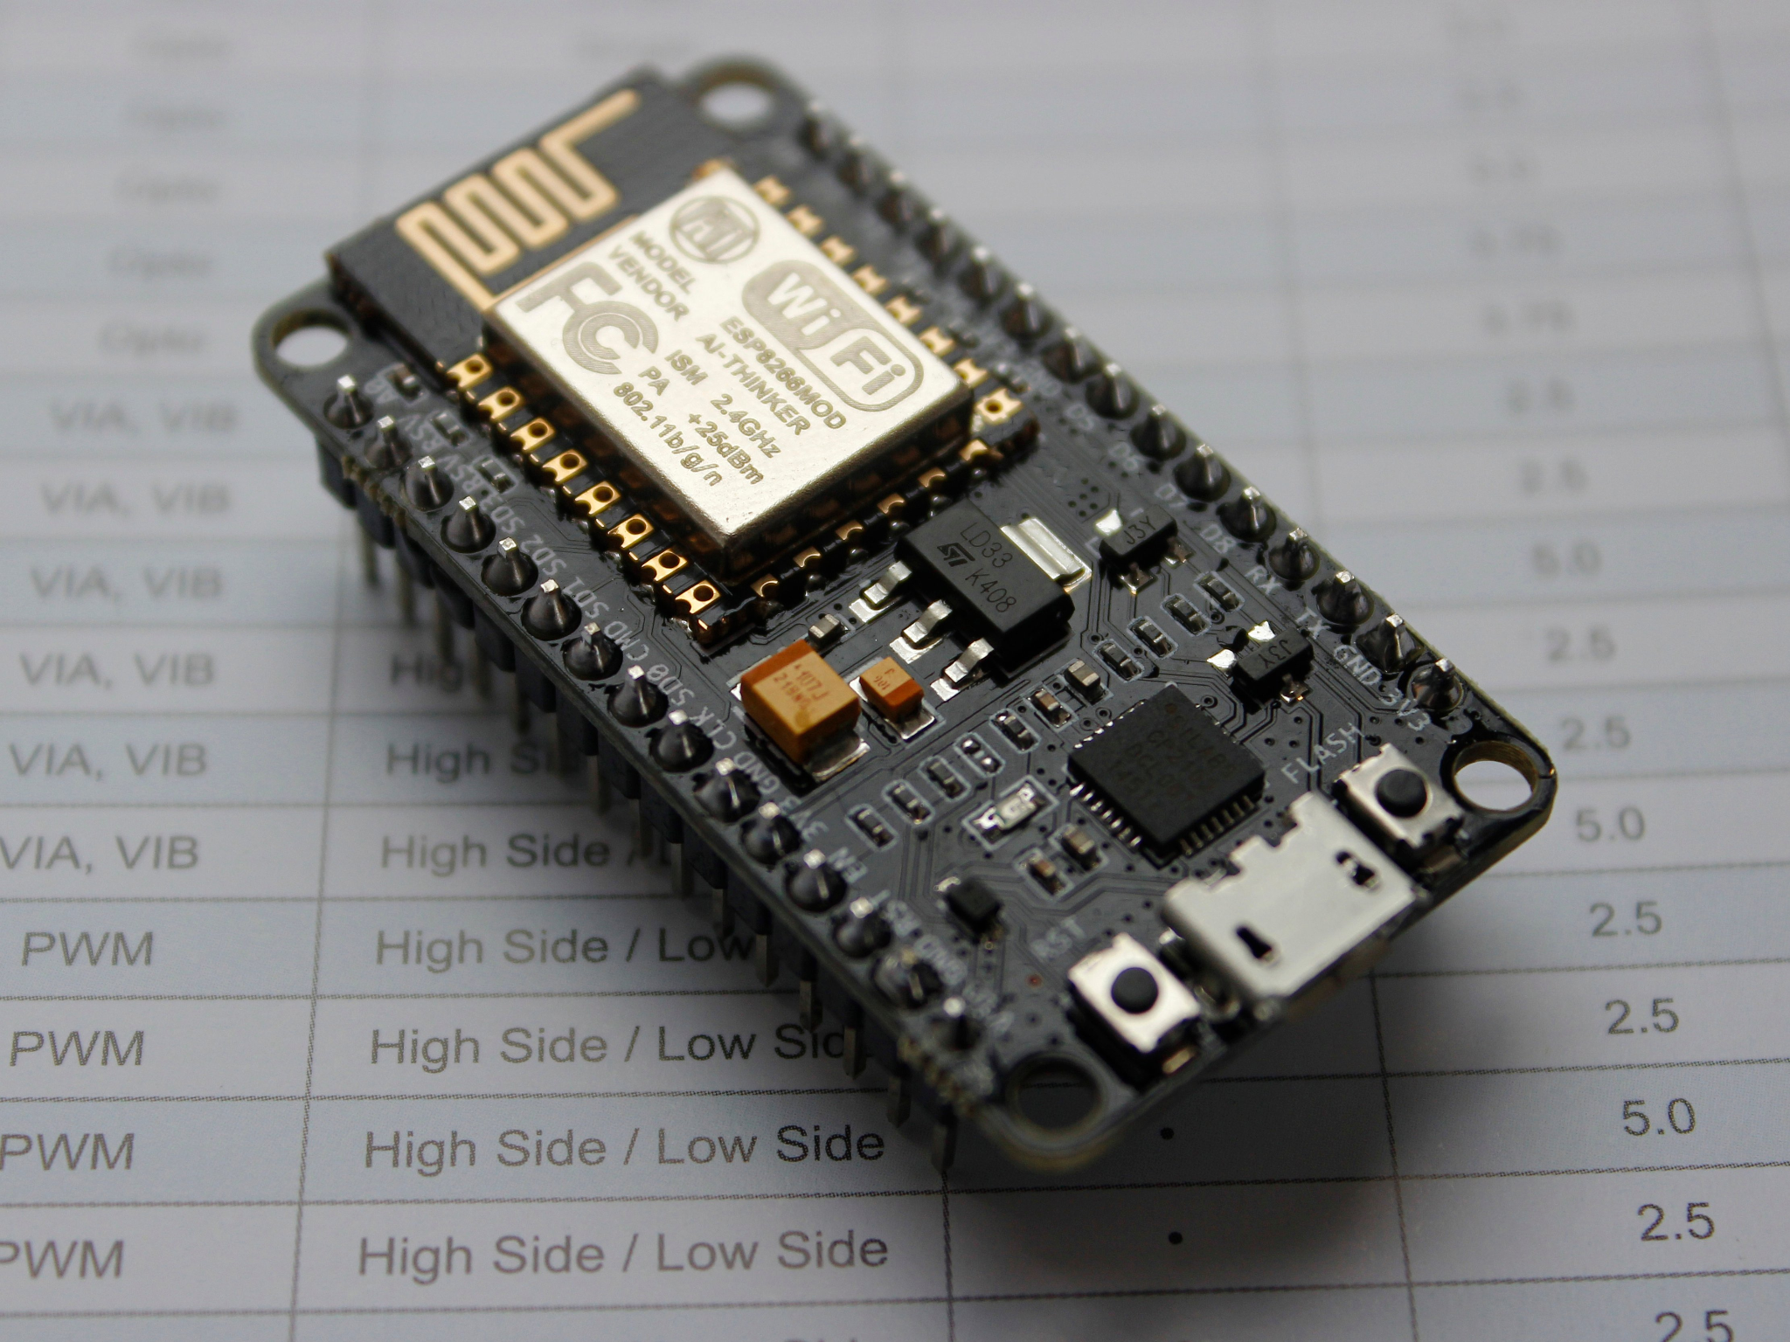
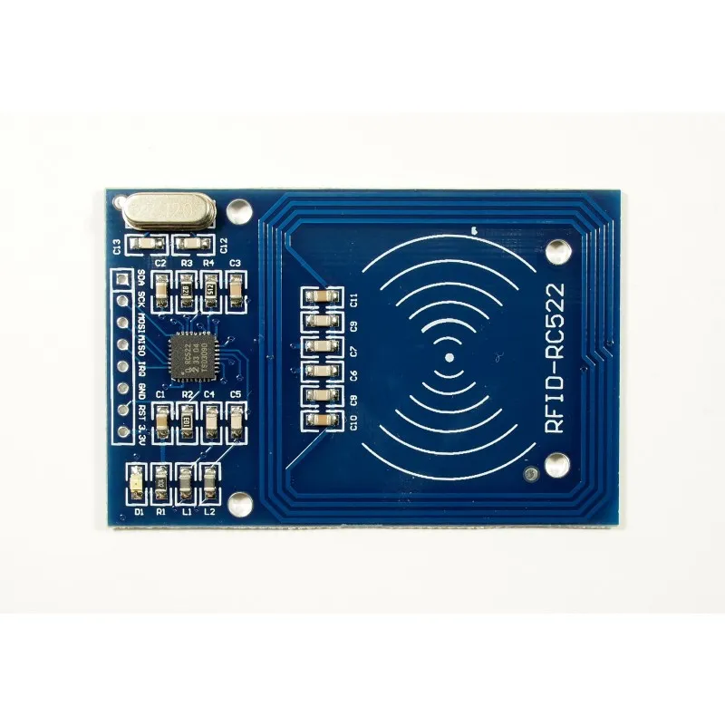
Hardware Components & Pin Configuration
NodeMCU (ESP8266)
RC522 RFID Reader

Slide 10
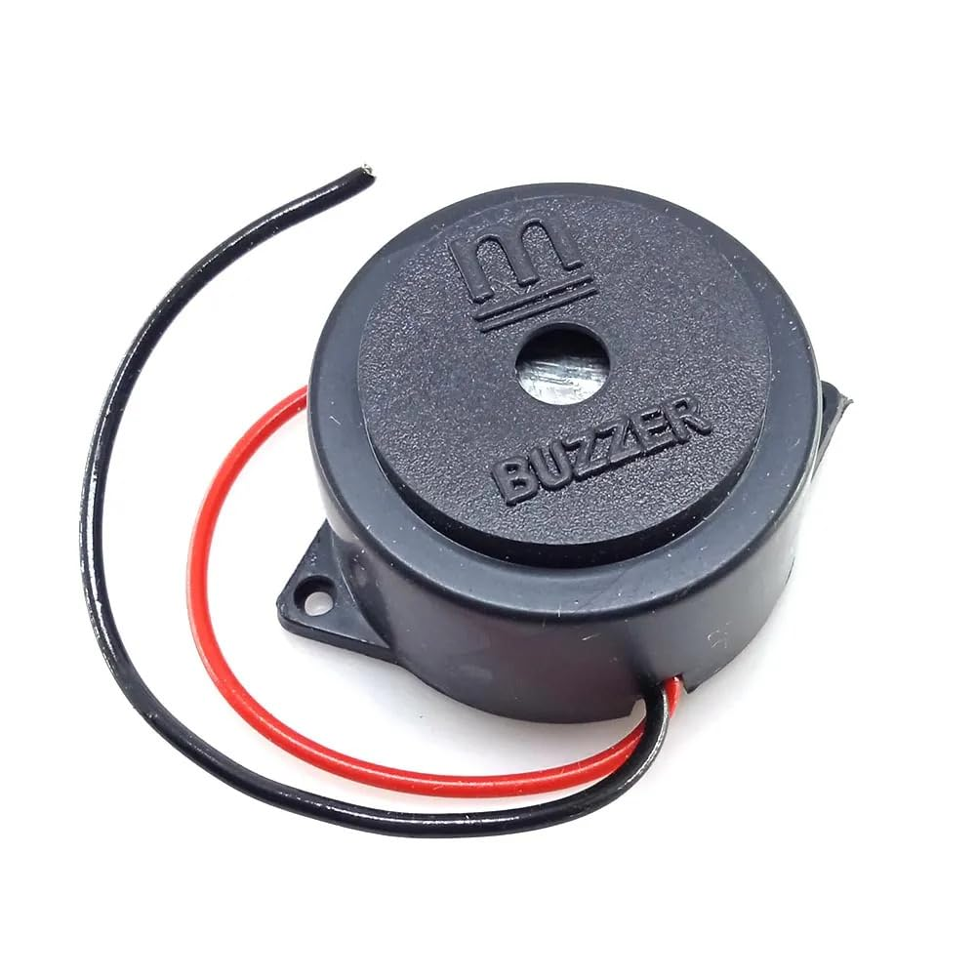
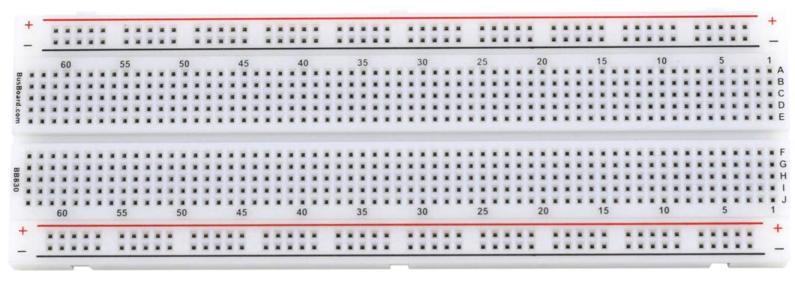
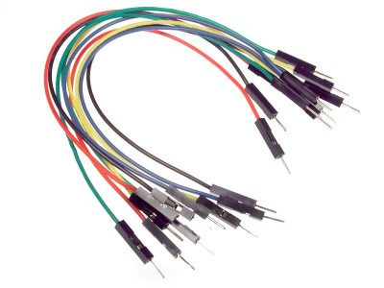
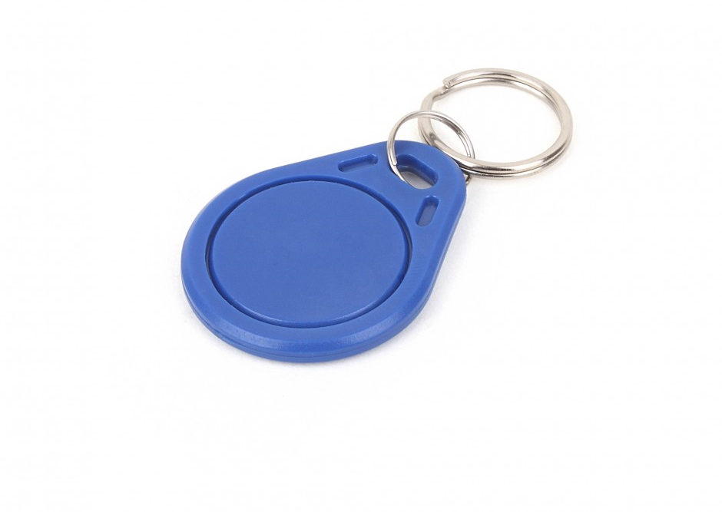
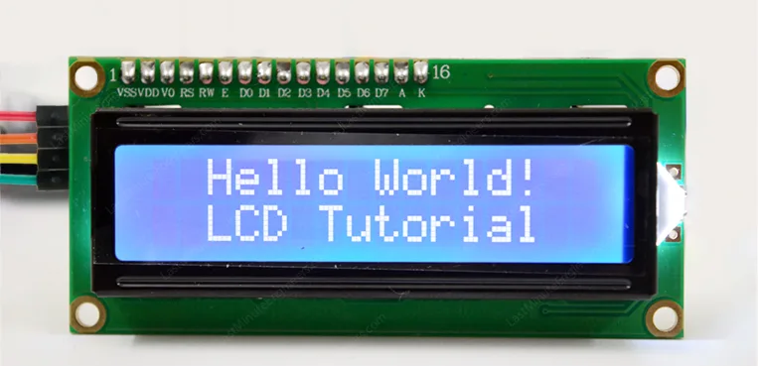
Buzzer
Breadboard
Jumper wires
16x2 I2c LCD Display
RFID Tags

Slide 11
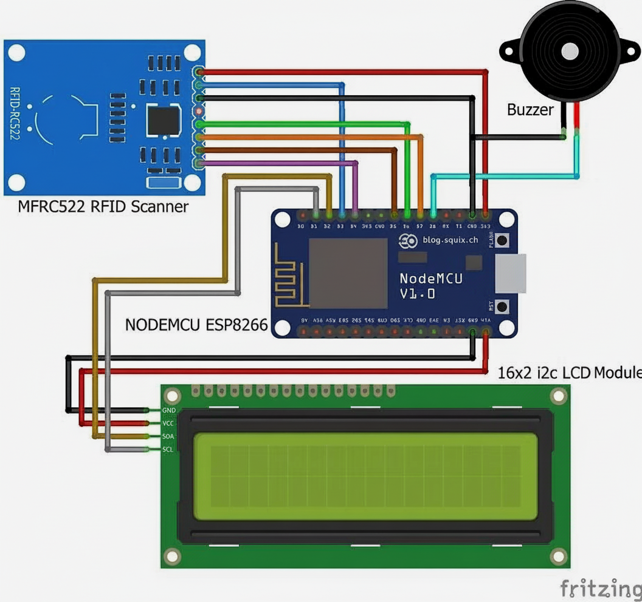
Circuit Diagram

Slide 12
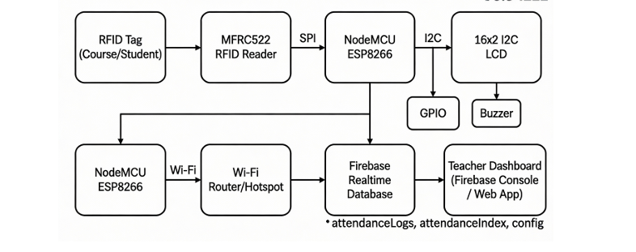
Application-level system overview

Slide 13
Database Design
/config/courses → course card mappings
/config/students → student UID to name mappings
- `/attendanceLogs/ <courses>/<sessionKey>` → real-time logs with timestamp
- `/attendanceIndex/<courses>/<sessionKey>` → duplicate prevention

Slide 14
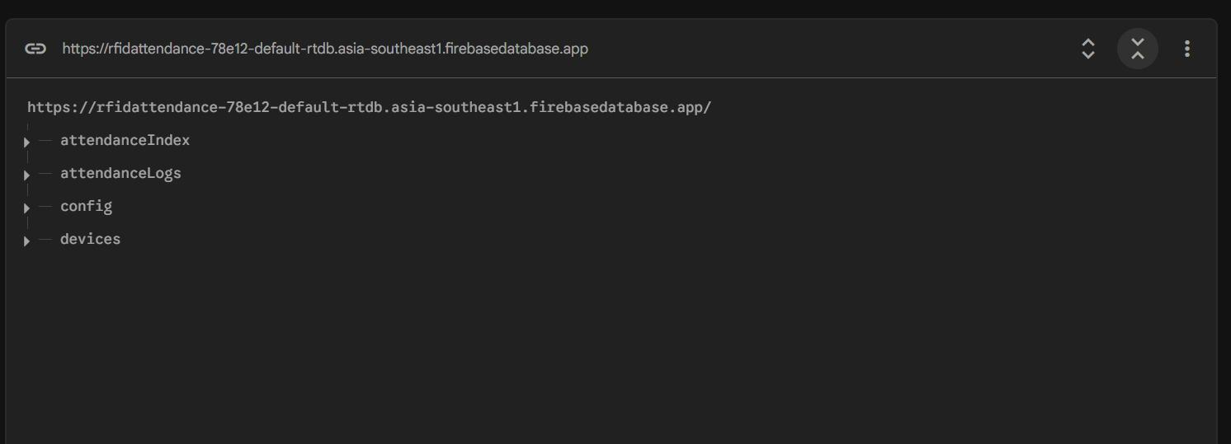
Firebase Structure

Slide 15
Software Implementation & Session Logic

Slide 16
Software Implementation & Session Logic
NodeMCU (Arduino) :
1) Startup (once) :
Connect to Wi‑Fi, initialize RC522 RFID reader, I2C LCD, buzzer, and connect to Firebase.
Sync time using NTP.
Load or use fixed settings: device ID ( DEV1), session duration (40 minutes).

Slide 17
Software Implementation & Session Logic
NodeMCU (Arduino) :
1) Startup (once) :
Connect to Wi‑Fi, initialize RC522 RFID reader, I2C LCD, buzzer, and connect to Firebase.
Sync time using NTP.
Load or use fixed settings: device ID ( DEV1), session duration (40 minutes).
2) Main loop (keeps running) :
The loop waits for tags and use Firebase as the source of truth

Slide 18
Firebase (database interaction)
A) Teacher scans course card → start session

Slide 19
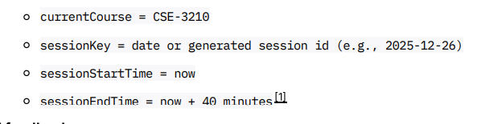
Firebase (database interaction)
A) Teacher scans course card → start session
Read /config/courses/<courseCardUID>

Slide 20
Firebase (database interaction)
A) Teacher scans course card → start session
Read /config/courses/<courseCardUID>
UI feedback:
LCD: show course + “Session started”
buzzer beep

Slide 21
B) Student scans during active session → validate + prevent duplicate + log

Slide 22
B) Student scans during active session → validate + prevent duplicate + log
1) Validate student

Slide 23
B) Student scans during active session → validate + prevent duplicate + log
1) Validate student
Read /config/students/ <studentUID> to get the name
If not found → LCD: “Invalid student”

Slide 24
B) Student scans during active session → validate + prevent duplicate + log
1) Validate student
Read /config/students/ <studentUID> to get the name
If not found → LCD: “Invalid student”
2) Duplicate prevention

Slide 25
B) Student scans during active session → validate + prevent duplicate + log
1) Validate student
Read /config/students/ <studentUID> to get the name
If not found → LCD: “Invalid student”
2) Duplicate prevention
Check `/attendanceIndex/<courseCode>/<sessionKey>/<studentUID>`
If it already exists → duplicate scan

Slide 26
B) Student scans during active session → validate + prevent duplicate + log
1) Validate student
Read /config/students/ <studentUID> to get the name
If not found → LCD: “Invalid student”
2) Duplicate prevention
Check `/attendanceIndex/<courseCode>/<sessionKey>/<studentUID>`
If it already exists → duplicate scan
3) Write attendance log

Slide 27
B) Student scans during active session → validate + prevent duplicate + log
1) Validate student
Read /config/students/ <studentUID> to get the name
If not found → LCD: “Invalid student”
2) Duplicate prevention
Check `/attendanceIndex/<courseCode>/<sessionKey>/<studentUID>`
If it already exists → duplicate scan
3) Write attendance log
Write `/attendanceIndex/<courseCode>/<sessionKey>/<studentUID> = true`
Push a new record under `/attendanceLogs/<courseCode>/<sessionKey>/<pushId>` with field

Slide 28
UI feedback:
LCD: “Attendance marked”
buzzer beep pattern

Slide 29
UI feedback:
LCD: “Attendance marked”
buzzer beep pattern
C) Timeout logic (40 minutes)

Slide 30
UI feedback:
LCD: “Attendance marked”
buzzer beep pattern
C) Timeout logic (40 minutes)
On each loop, the code checks current time. If now > sessionEndTime system ends the session.

Slide 31
Testing & Results
Test 1: Course Selection

Slide 32
Testing & Results
Test 1: Course Selection
✓ Scans course card
✓ LCD shows: "Session: CSE-3210 (11:00-11:40)"
✓ Record created in Firebase with timestamp

Slide 33
Testing & Results
Test 1: Course Selection
✓ Scans course card
✓ LCD shows: "Session: CSE-3210 (11:00-11:40)"
✓ Record created in Firebase with timestamp
Test 2: Student Card Scan

Slide 34
Testing & Results
Test 1: Course Selection
✓ Scans course card
✓ LCD shows: "Session: CSE-3210 (11:00-11:40)"
✓ Record created in Firebase with timestamp
Test 2: Student Card Scan
✓ Student UID (63563B14) scanned
✓ Record created in Firebase with timestamp: 11:15:07
✓ LCD shows: "Attendance Marked ✓"

Slide 35
Testing & Results
Test 3: Duplicate Scan Prevention

Slide 36
Testing & Results
Test 3: Duplicate Scan Prevention
✓ Same student card scanned again (5 sec later)
✓ System blocks: "Already Scanned"
✓ NO duplicate record created in database

Slide 37
Testing & Results
Test 3: Duplicate Scan Prevention
✓ Same student card scanned again (5 sec later)
✓ System blocks: "Already Scanned"
✓ NO duplicate record created in database
Test 4: Session Timeout

Slide 38
Testing & Results
Test 3: Duplicate Scan Prevention
✓ Same student card scanned again (5 sec later)
✓ System blocks: "Already Scanned"
✓ NO duplicate record created in database
Test 4: Session Timeout
✓ Scan attempted after 40-minute window
✓ System rejects: "Session Ended"
✓ Attendance window closed successfully

Slide 39
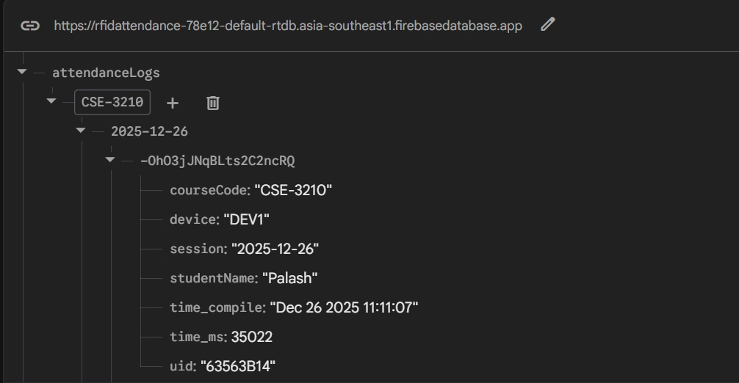
Real-time Data Synchronization

Slide 40
Key Achievements
Successfully implemented IoT-based attendance automation

Slide 41
Key Achievements
Successfully implemented IoT-based attendance automation
Real-time cloud synchronization using Firebase

Slide 42
Key Achievements
Successfully implemented IoT-based attendance automation
Real-time cloud synchronization using Firebase
Practical session management

Slide 43
Key Achievements
Successfully implemented IoT-based attendance automation
Real-time cloud synchronization using Firebase
Practical session management
From manual Google Sheets to cloud-native Firebase architecture

Slide 44

Future work
Teacher web/mobile dashboard for viewing filtered attendance

Slide 45
Future work
Teacher web/mobile dashboard for viewing filtered attendance
Role-based access control (admin, teacher, student)

Slide 46
Future work
Teacher web/mobile dashboard for viewing filtered attendance
Role-based access control (admin, teacher, student)
Two way verification (face authentication)

Slide 47


Thank you!

